Slide 1
What’s the problem?
A focused ethnography exploring experiences and social interactions in problem-based learning in nurse education
Carlin, A., Allen-Collinson, J., Kane, R., Black, S. and Pierazzo, J.

Slide 2
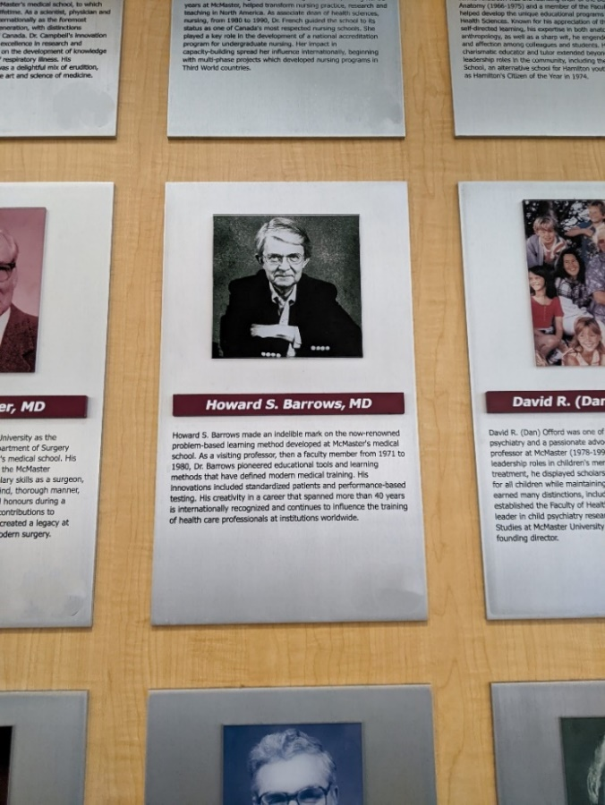
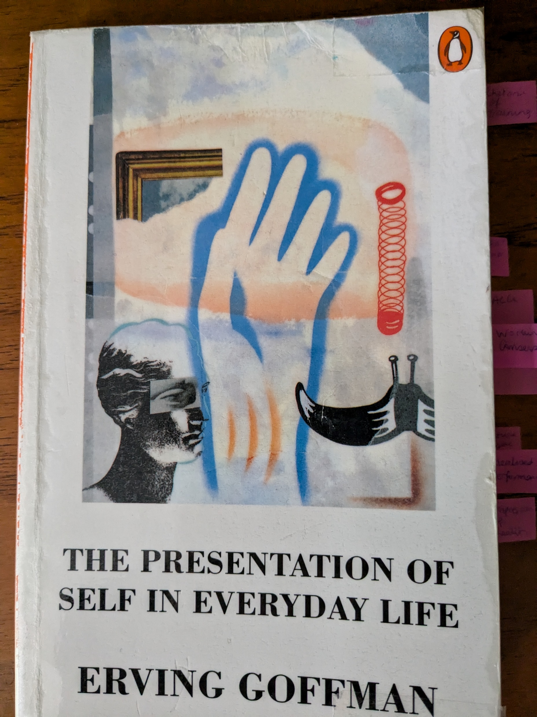
Research aim and methodology
Interpretivist, constructionist perspective used for analysis of social interactions and experiences of PBL seminars in nurse education.
33 interviewees and 56 participants observed across three field sites (North America & UK).
26 fieldnotes and 33 interview transcripts analysed via reflexive thematic analysis (Braun and Clarke, 2022)
Theoretically, Goffman’s (1959) principles of dramaturgy used in analysing PBL seminars as performance and interaction ritual.

Slide 3
Findings
From in-depth data analysis, three themes were developed:
Mindset evolution to describe the social geography of the performance.
Nursing is also a team sport to highlight the interaction and experiences of working in teams
Rekindle the discussion to focus on the various roles of the facilitator.

Slide 4
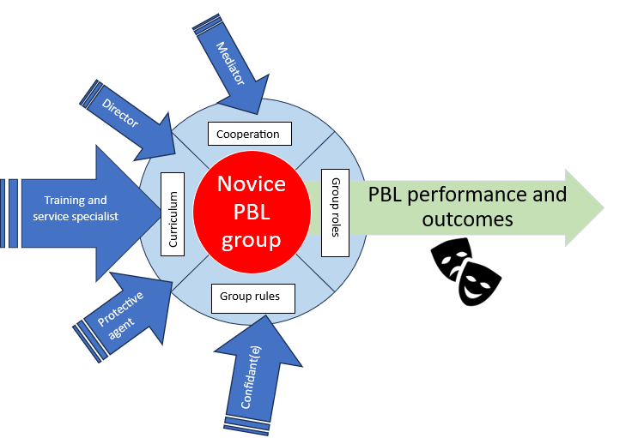
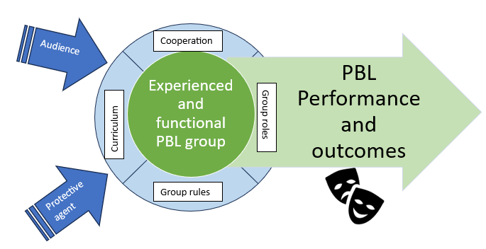
Considerations for nurse education
PBL performance for an experienced PBL group
PBL performance for a novice PBL group

Slide 5
References
Blumer, H. (1969) Symbolic interactionism: perspective and method. Englewood Cliffs: Prentice Hall.
Braun, V. and Clarke, V. (2022) Thematic analysis: a practical guide. London: Sage Publications Ltd.
Goffman, E. (1959) The presentation of self in everyday life. London: Penguin Books.
Goffman, E. (1961) Asylums: essays on the social situation of mental patients and other inmates. London: Penguin Books.
Goffman, E. (1963) Stigma: notes on the management of spoiled identity. London: Penguin Books.
Goffman, E. (1967) Interaction ritual: essays in face-to-face behavior. Brunswick, New Jersey: Transaction Publishers.
Goffman, E. (1971) Relations in public: microstudies of the public order. Abingdon: Routledge.

