Slide 1
Putting on the show: an ethnographic investigation into experiences of problem-based learning in nurse education
Dr Alexandra Carlin, Lincoln Bishop University, UK.
Prof. Jacquelyn Allen-Collinson, University of Lincoln, UK.
Prof. Ros Kane, University of Lincoln, UK.
Dr Sharon Black, University of Nottingham, UK.
Dr Joanna Pierazzo, McMaster University, Canada.
Notes:
“All the worlds a stage, and all the men and women merely players”. My name is Alexandra Carlin and for this research, me and my fellow performers (who could not make it today) took this Shakespearian monologue quite literately to explore the experiences, and social interactions, of PBL in nurse education. Prior to commencing this presentation, please may I extend my thanks to everyone who was involved with this research.

Slide 2
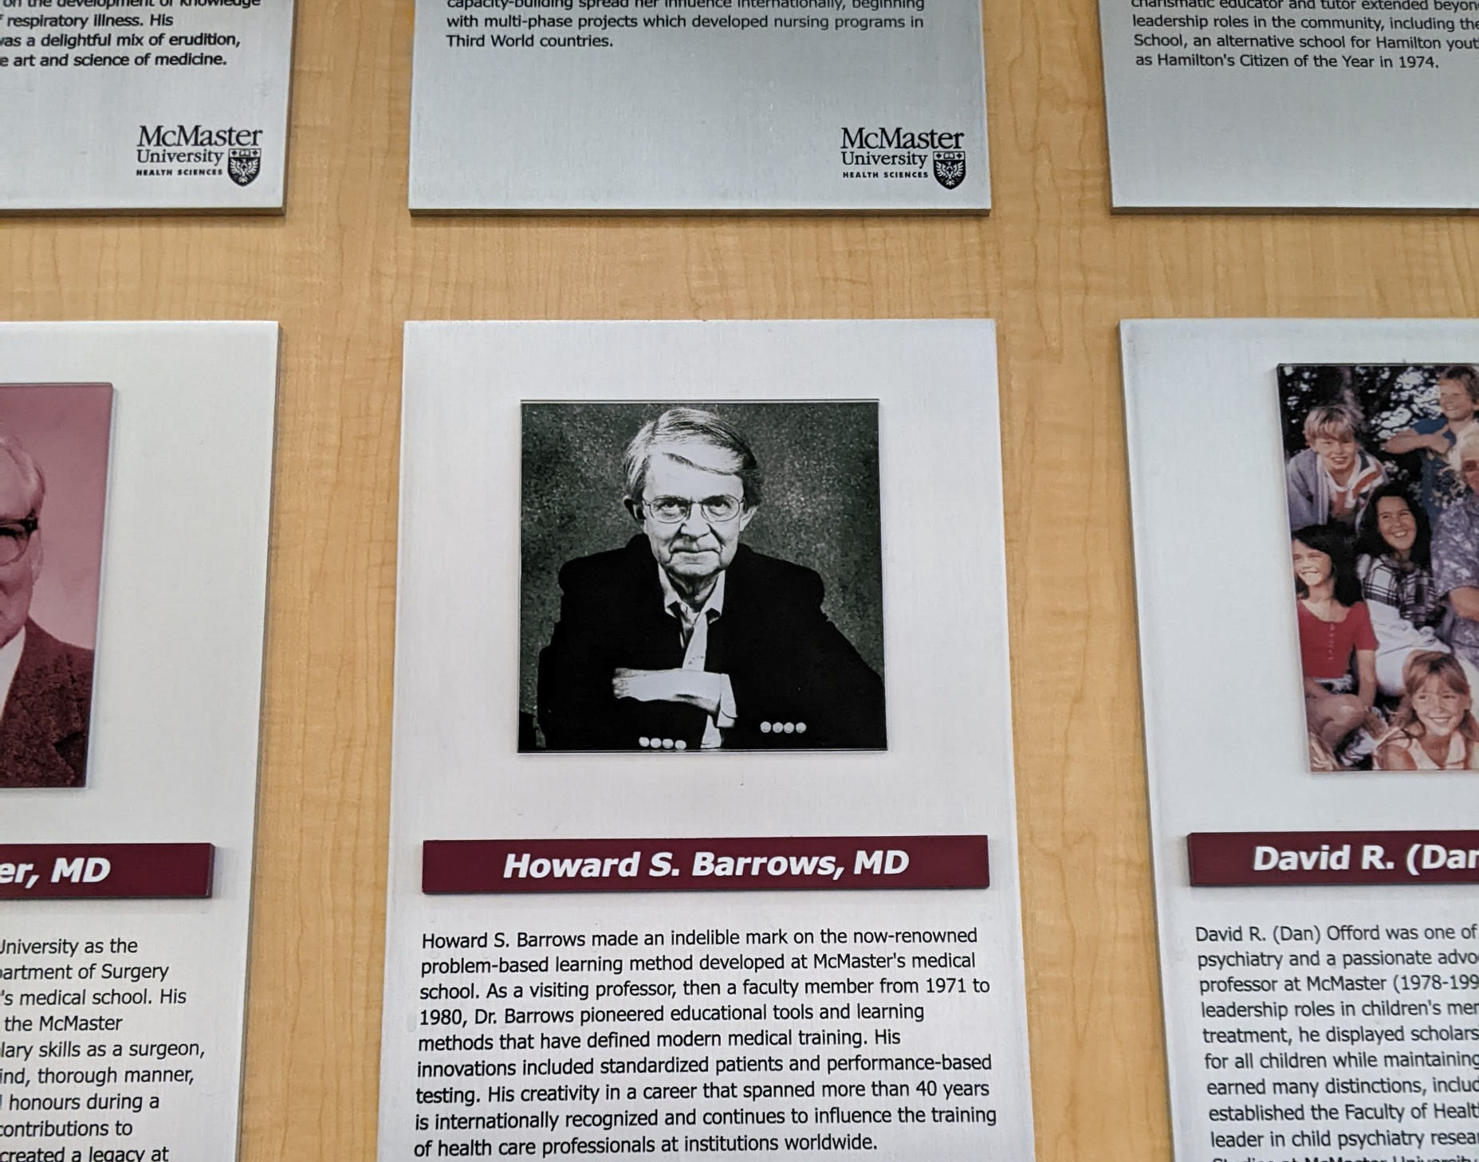
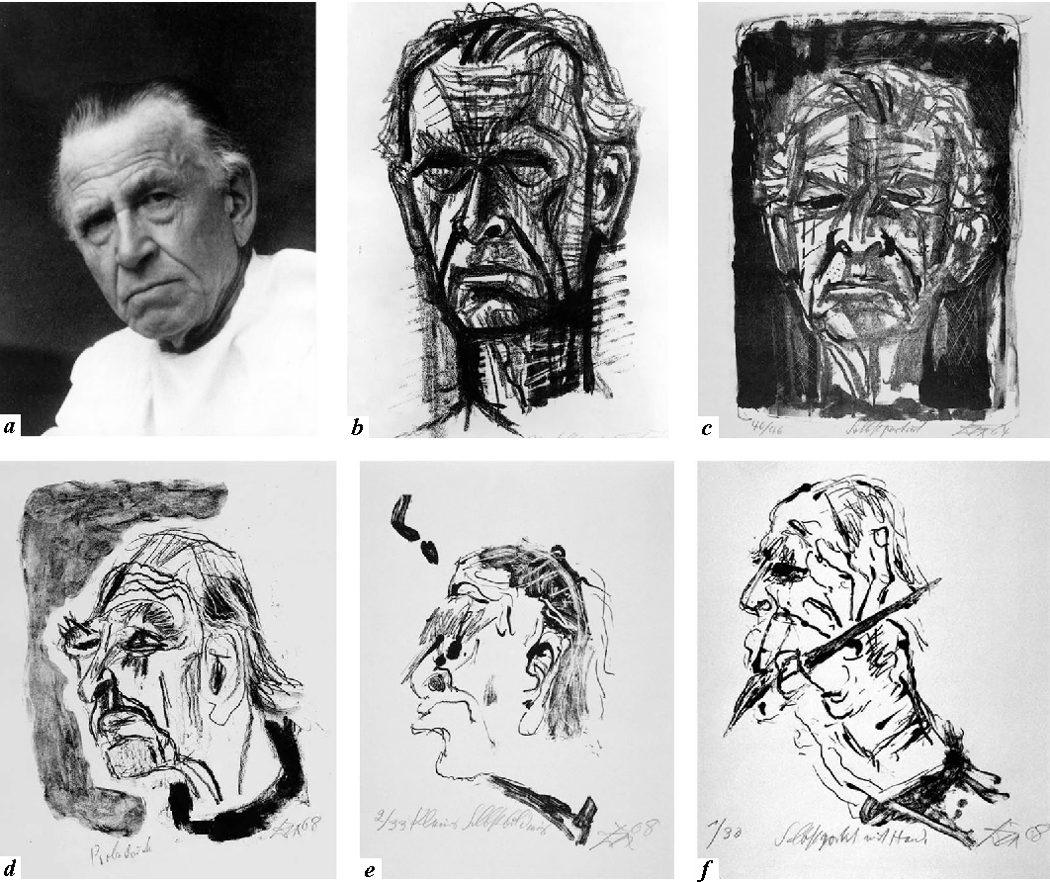
Introduction
Problem-based learning (PBL) is a learning approach where students work together towards the understanding of a problem (Barrows 1996), rather than being instructively ‘taught’.
In general, students undertaking PBL have opportunities to develop their collaborative working skills by working in small teams where they share, compare and debate information (Wosinski et al. 2018).
Social interaction therefore lies at the heart of effective PBL, which requires considerable social skills, and the development of team cohesion (Cooper and Carver 2012).
The requirement to work in groups can “make or break” the approach.
We recognised a relative lacuna of micro-sociological studies focusing on the social interactional aspects of PBL.
Notes:
Problem based learning (or PBL) is a student-centred pedagogy that developed in the 1960s following widespread student dissatisfaction with traditional, more didactic approaches to learning. In response to such discontent, McMaster Medical School introduced a more active, student-centred learning approach, termed PBL. This is a learning approach where students work together towards the understanding of a problem (Barrows, 1996), rather than being instructively ‘taught’. The approach has no single, unified process, but in essence students would work in small groups to explore a “trigger”. This could be a short vignette as part of an evolving case, an image, a letter or even artwork, such as the example provided here. In this example, “problems” would consist of the psycho-social aspect of living post stroke, such as impact on the artist’s occupation, impact on dexterity, lost sense of belonging, social identity. Individual group members would then develop their knowledge of their allocated problem, so that when the group reconvenes, they can share and present this knowledge with their peers.
In general, students undertaking PBL have opportunities to develop their collaborative working skills by working in small teams where they share, compare and debate information (Wosinski et al., 2018). Social interaction therefore lies at the heart of effective PBL, which requires considerable social skills, and the development of team cohesion (Cooper and Carver, 2012). Whilst students often report enjoying the opportunity to collaborate via this format (Arpanantikul and Luecha, 2010; Spiers et al., 2014), disappointingly, lower standards of work have been reported (Cooper and Carver, 2012) and reliance on other group members to generate and share learning can prove problematic (Allert et al., 2022; Spiers et al., 2014).
Despite the wide-ranging literature on various aspects of professional nurse education, at the time of commencing the current research, there was a relative lacuna of micro-sociological studies focusing on the social interactional aspects of PBL. An interpretivist perspective was adopted, in alignment with the goal of exploring PBL from the perspectives of students and facilitators themselves, via an ethnographic study.

Slide 3
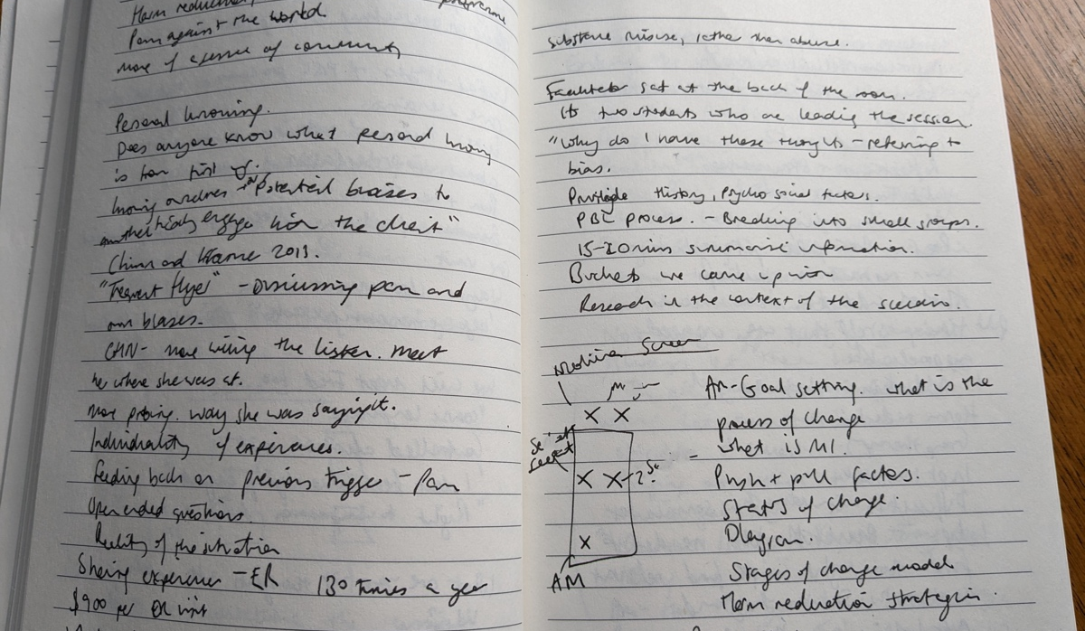
Methodology
Interpretivist, “focused ethnographic” approach.
Explored the experiences and social interactions of PBL in nurse education.
33 interviewees and 56 participants observed across three field sites (North America & UK).
26 fieldnotes and 33 interview transcripts analysed via reflexive thematic analysis (Braun and Clarke, 2022).
Theoretically, Goffman’s (1959) principles of dramaturgy used in analysing PBL seminars as performance and interaction ritual.
Ethical approval granted across all three field sites.
Notes:
Under the rubric of interpretivism, a ‘focused ethnographic’ approach was selected as a practical means of undertaking research for my part-time doctoral study. This precluded the possibility of using a more ‘traditional’ ethnographic mode involving extended periods of fieldwork and longer immersion in the field. Using this interpretive perspective, the experiences and social interactions of PBL were explored from the perspectives of the students and facilitators themselves, via observation and interviews.
Data were collected from three university field sites: two in the UK, labelled below as: ‘UK One’ and ‘UK Two’, and one in North America. A purposive sampling strategy was used to recruit students and facilitators, using virtual learning environments. It should be noted that participants from UK One referred to PBL as EBL (enquiry-based learning), but as the purpose and practices of EBL were portrayed as identical to PBL, they were still included in the research
A total of 33 participants subsequently took part in online, audio-visually recorded, semi-structured interviews of around 60 minutes’ duration. In addition, 56 participants were observed, both online and in physical classrooms, providing 65 hours of observational data.
The data were analysed by drawing on Braun and Clarke’s (2022) suggestions for reflexive thematic analysis. Ethical approval was granted by three ethical review boards, to study students and facilitators in their everyday “natural” university settings both online, and in-classrooms.

Slide 4
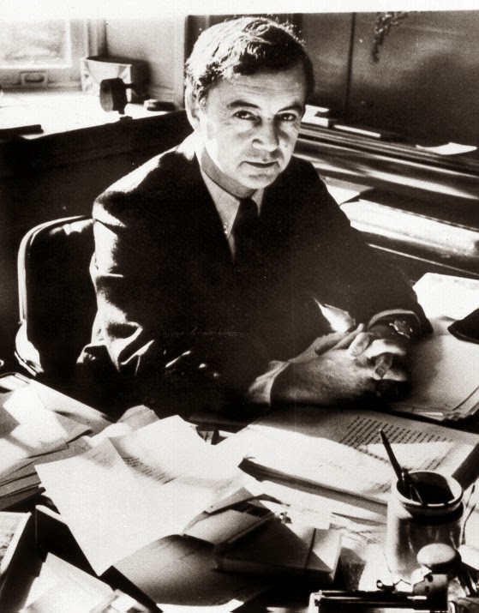
Theoretical framework
The study draws on various works by Erving Goffman in the microsociology of everyday life, particularly his dramaturgical analyses of the interactional order (Goffman, 1959, 1967, 1971).
For Goffman, people carefully construct and enact roles in interactions, seeking to elicit desired responses from their audience, akin to a performance dependant on social actors.
Formal “front-stage” or “front region” and informal “back-stage” or “back region”.
These regions blurred and shifted during online teaching, due to the COVID-19 pandemic.
Notes:
To contextualize the research, I will briefly discuss the theoretical framework employed in the analysis. This research draws on the various works by Erving Goffman on the microsociology of everyday life, particularly his dramaturgical analyses of the interactional order (e.g., Goffman, 1959, 1967, 1971). For Goffman (1959), social actors carefully construct and enact roles in their interactions, seeking to elicit desired responses from their audience. In this regard, within PBL the students become actors within a performance ritual with the facilitator analogous to an audience member. Goffman’s work is complex and multi-faceted, but he (e.g., 1959) makes a distinction on the roles and interaction played out in more formal ‘front stage’ or ‘front regions’, and those occurring in the more informal context of ‘backstage’ or ‘back regions”. A social actor might seek to present very different performances to different audiences; for example, presenting as a middle-class, articulate, knowledgeable academic when front stage before an audience of students, but giving a rather different working-class, ‘matey’ performance when meeting old friends in a hometown bar.
With the advent and rapid increase in the use of online teaching and learning approaches, especially during the restrictions on face-to-face learning environments during the COVID-19 pandemic, any strict demarcation between the front stage of a university classroom and the backstage of a student’s or tutor’s home became blurred and shifting.

Slide 5
Findings
Putting on the show
Teams at work
Directing the performance
Notes:
Three primary themes were developed from analysing the data set.
Putting on a show describes the social geography of the performance.
Teams at work highlights the social interactions and experiences of working in teams.
Directing the performance focused on the facilitator.

Slide 6
Putting on the show
Students were performers trying to “pull off” a performance, using a variety of formats, including pamphlets, information books, role play, food substances and even textiles. The idealised performance consisted of PowerPoint, although this was problematic:
“It's less ‘death by PowerPoint™’ and just ‘death by information’ for me. If it's just facts, facts, facts…and blocks of knowledge/information and no time to really think or process it. Then it kind of feels like a wall of information hit you in the face and then you feel a bit: I need to switch off from this cos it's a bit much (Tamara interview, UK One).”
As a result, students demonstrated visible displays of inattention and withdrawal, signalling dissatisfaction with the performance. Shirley described an unhappy realisation that she need to “up her game” and adjust to a more creative performance, although she was left frustrated:
“When I did the Bingo thing, I got quite a lot of criticism and, pardon my French, but I thought: well, fuck this, I've tried to make this interesting and a bit of fun and you're complaining. Fine, I won't do it again. I'll do a PowerPoint™ like everybody else you know, or an academic poster or whatever. Because you just start to think: well, I'm doing it to try and get things across, but they [audience] don't care either… (Student Shirley interview, UK One).”
When online, front and back regions became blurred, with those presentations of self normally reserved for the relaxed, informal setting of backstage entering the front region, sometimes suddenly and unexpectedly.
“Sorry guys, not having a camera on, I’m in my dressing gown” (Eric, UK Two).
Notes:
Putting on the show - Drawing on Goffman’s (1959) dramaturgical insights promoted the analysis of students (both individually and in group/team contexts) as performers trying to ‘pull off’ a performance in front of other students and the facilitator. PBL performances were found to be highly diverse, varying in format across groups and sites. To stimulate discussion, staff and students presented information through a variety of media, using a range of ‘sign equipment’, such as concept maps, and video case studies. The authenticity of such sign equipment were, however, subject to questioning and critique by students.
Formats of the performances varied considerably, spanning the more traditional use of pamphlets, information books, and role play, to highly creative input from students, such as the use of food substances and even textiles as learning aids, with one student who made an entire bowel out of fabric.
For some students, the use of Powerpoint™ slides was considered part of an ‘idealised’ performance, mirroring lecturers’ use of slide presentations. As Goffman (1959, p. 44) notes, there is a “tendency for performers to offer their observers an impression that is idealised” seeking to put on a show that the performer considers the audience will valorise. Unfortunately, the supposedly ‘idealised’ Powerpoint™ performance could often elicit boredom or ‘death by PowerPoint™’ as reported by Facilitators. Although for Student Tamara it was more “death by information”:
“It's less ‘death by PowerPoint™’ and just ‘death by information’ for me”(Tamara interview, UK One).”
As a result, students demonstrated visible displays of inattention and withdrawal, signalling dissatisfaction with the performance. Shirley described an unhappy realisation that she need to up her game and adjust to a more creative performance, although she was left frustrated:
“When I did the Bingo thing, I got quite a lot of criticism and, pardon my French, but I thought: well, fuck this, I've tried to make this interesting and a bit of fun and you're complaining. Fine, I won't do it again. I'll do a PowerPoint™ like everybody else you know, or an academic poster or whatever. Because you just start to think: well, I'm doing it to try and get things across, but they [audience] don't care either… (Student Shirley interview, UK One).”
During online PBL, front and back regions often became blurred, with those presentations of self normally reserved for the relaxed, informal setting of backstage entering the front region, sometimes suddenly and unexpectedly. Goffman (1959, p. 114) describes the back region as an area where performers can relax and engage in more informal behaviour away from the gaze of the audience. In the online environment, it often became apparent that performers were encountering competing role demands, even a degree of role conflict between their work-based student role and home-based roles, including as parents or carers. The voices of children could be heard, for example, and occasionally the blurred head of a child appeared on the camera feed, as students sought to combine their roles as student and homeschooler. Personal items, normally reserved for back regions, also became visible in the online classroom: items of clothing, bottles of perfume, and children’s party balloons all made impromptu appearances. Washing machines, dogs barking, and doorbells were just some of the back-region sound effects made audible via the online feed. Performers sometimes avoided being caught in a state of relative undress by not switching on their computer or phone cameras. For example, Student Eric attended the online lesson in his dressing gown, and sought to maintain informational preserve (Goffman, 1961, p. 32) about this breaching of self-presentational norms in public:
“Sorry guys, not having a camera on, I’m in my dressing gown” (Eric, UK Two).

Slide 7
Teams at work
Goffman (1959, p. 85) uses the term ‘team’ to refer to “any set of individuals who cooperate in staging a single routine” within a particular performance.
“At the end of the day, like, the main point is nursing and everything, but nursing is also a team sport. It's important to have support. It's important to have friends. I mean, yes, it's kind of awkward at the beginning because they're forcing you to interact” (Student Rita interview, North American site).
Use of roles, for example, designated the following roles: 1) recorder (note-taker); 2) timekeeper; 3) reporter; and 4) lead.
“I think they just go with the flow…I have to admit the roles do seem to disappear” (Facilitator Milla interview, UK Two).
Use of ground rules, or mechanisms to address renegade performers.
“What happens is the rest of the group decide: well, this person never does anything anyway, so let's make up (a topic). There's six of us. We're all going to go off and find out about these six different things. We'll make up a seventh that doesn't really matter, give it to this person because we know they won't do it anyway…Then there'll be other groups that would really challenge those people and say: you need to be doing this stuff, it's not fair, you're gonna get a degree just the same as me and you haven't turned up” (Facilitator Kimberley interview, UK One).
Notes:
Teams at Work - Goffman (1959, p. 85) uses the term ‘team’ to refer to “any set of individuals who cooperate in staging a single routine” within a particular performance. In contrast to everyday usage of the term, a team can consist of one person (Goffman, 1959) or multiple actors, who seek to put on and maintain a credible performance during social interaction. Team members usually work together ‘on-team’ to coordinate their actions, avoid undermining each other, and maintain a unified, coherent front. As Edgley (2022) argues, teams can be deemed ‘good’ if they contribute to the desired impression, or ‘bad’ if they ‘give the show away’; that is, they make it apparent that it is a show being staged.
The need for team performances initially seemed strange to some nursing students, who were more accustomed to student roles as individualized and often competitive, rather than cooperative between students. Rita, for example, acknowledged the initial awkwardness of team interaction:
At the end of the day, like, the main point is nursing and everything, but nursing is also a team sport. It's important to have support. It's important to have friends. I mean, yes, it's kind of awkward at the beginning because they're forcing you to interact (Student Rita interview, North American site)”
Within PBL teams, there were formal roles that students adopted to help maintain and regulate performance. The North Amercian site, for example, designated the following roles: 1) recorder (note-taker); 2) timekeeper; 3) reporter; and 4) lead. One of the UK sites drew on seven roles that were available for students’ self-selection: 1) lead; 2) scribe; 3) researcher; 4) timekeeper; 5) checker; 6) encourager; and 7) wildcard. Interestingly, however, students, particularly at the UK Two Site, rarely adhered to the designated roles, as both facilitators and students noted:
“I think they just go with the flow…I have to admit the roles do seem to disappear (Facilitator Milla interview, UK Two).
Goffman (1971) highlights the necessity of rules (often tacit) in structuring and making possible everyday interactions in public. Without social actors’ acknowledgement of, and general adherence to such rules, public life would be rendered difficult, and, in the case of some rules, for example relating to road usage, highly dangerous. Goffman (1983, p. 5) refers to ‘ground rules’ that are used to secure (or a least to seek) normative consensus. Within the PBL seminars, rules were generally acknowledged and observed, including those relating to ‘decorum’ intra and inter teams.
Despite such normative expectations, however, miscreant or ‘bad performers’ could still disrupt the performance, or fail to turn up at all, thus endangering the entire performance. In such cases, remedial action would be required, either to foresee and offset the disruption, or to mitigate its consequences during the performance. Facilitator Kimberley offered one such example, where she facilitated who used a “fake” topic area to remedy the potential ‘bad’ behaviour of one team member well-known for a lack of input:
“What happens is the rest of the group decide: well, this person never does anything anyway, so let's make up (a topic). There's six of us. We're all going to go off and find out about these six different things. We'll make up a seventh that doesn't really matter, give it to this person because we know they won't do it anyway…Then there'll be other groups that would really challenge those people and say: you need to be doing this stuff, it's not fair, you're gonna get a degree just the same as me and you haven't turned up” (Facilitator Kimberley interview, UK One).

Slide 8
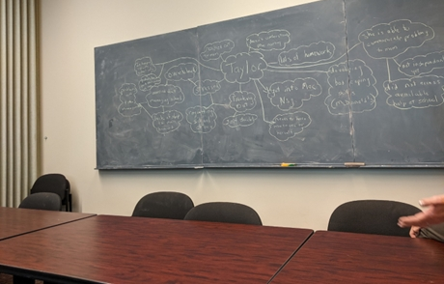
Directing the performance
Facilitator has responsibility for the overall management and orchestration of the PBL session – Akin to stage directors.
“If there was a natural pause where it appears that the group stalled or they’re not quite sure, my next approach would be to try and rekindle the discussion” (Facilitator Wade, UK Two).
Some students expressed dissatisfaction, even cynicism, regarding the facilitator role, seeing PBL as an “easy option” for lecturing staff.
“Let's say I was facilitating EBL at X (University) on the course that I'm doing, I would think it was an easy job, you know, that racks up some teaching hours, because the onus is on the students. The facilitator does little to no prep. Um, and they don't actually facilitate anything, I would say” (Student Shirley interview, UK One).
The facilitator should, it required, use their position of power to address conflict issues, particularly when student participation contributed to a grade.
Students appeared to valorise facilitators who still worked in clinical environments:
“I do tell them the story about the patient who was given an inhaler for the cat because of their allergies and went home and squirted it on the cat” (Facilitator Elektra interview, UK Two).
Facilitators also held the role of a “training specialist” to role model the professional status and/or a “service specialist” to repair the show, particularly if students demonstrated unsafe or unprofessional practice.
Notes:
Directing the performance -The PBL facilitator role, as the title connotes, is geared to facilitating students’ learning via providing information, resources and support, rather than using a more didactive approach. The facilitator has responsibility for the overall management and orchestration (or direction, in dramaturgical terms) of the PBL sessions. Akin to stage directors, facilitators might not appear as the most dramatically important figures on stage, and their visible role in the performance might seem minimal, especially if the performance is going well. In the PBL context, facilitators generally opted for a more nurturing and encouraging directorial role, providing ‘prompts’ to students, rather than orders.
Wade, for example, explained how he would give prompts to ‘rekindle the discussion’ if a group stalled or appeared unsure.
Interestingly, some students expressed dissatisfaction, even cynicism, regarding the facilitator role, seeing PBL as an ‘easy option’ for lecturing staff. Shirley, for example, was not convinced that much work was required of facilitators:
“Let's say I was facilitating EBL at X (University) on the course that I'm doing, I would think it was an easy job, you know, that racks up some teaching hours, because the onus is on the students. The facilitator does little to no prep. Um, and they don't actually facilitate anything, I would say” (Student Shirley interview, UK One)
Her mention of ‘rack[ing] up teaching hours’ also indicates awareness of academic workload planning within higher education in the UK, where staff are required to undertake a set number of hours of teaching during the academic year (Hayes, 2017).
Nursing academics who still worked in clinical environments were particularly valued by students for their expertise, and being able to draw on powerful illustrative examples from their own professional practice. During the observations, for example, Facilitator Elektra offered an example, from her clinical role as a respiratory matron.
I do tell them the story about the patient who was given an inhaler for the cat because of their allergies and went home and squirted it on the cat (Facilitator Elektra interview, UK Two).
It was these stories, grounded in lived experience, that brought theory to life for students, within a context that felt relatable to practice. If, in contrast, facilitators themselves felt under-experienced or lacking in specific expertise to answer a student question, ‘covering’ techniques could be used to disguise a lack of knowledge and thus potential loss of face (Goffman, 1967).
Facilitators also held the role of a “training specialist” to role model the professional status and a “service specialist” to repair the show, particularly if students demonstrated unsafe or unprofessional practice. Facilitators frequently desired the need to witness safe and effective practice.
.

Slide 9
Conclusion
Goffman’s dramaturgical analysis was found highly applicable to PBL in nurse education, where student teams are responsible for staging performances, albeit with the light-touch directorial role of a facilitator.
As the data illustrate, PBL can be an unpredictable pedagogy, due to its reliance on sustained social interaction, and the performances of novice actors (nursing students) who must cooperate in team working to ‘stage the show’ competently.
Our findings also highlight how the facilitator role fluctuates contextually, commensurate with interactionist perspectives on the salience of social context in shaping social interaction.
Notes:
Goffman’s interactionist work offered a powerful theoretical framework for generating original insights into PBL as a performance. PBL can be an unpredictable pedagogy, due its reliance on sustained social interaction, need for collaboration and teamworking, particularly as novice actors (students) must cooperate in team working to “stage the show” competently. The facilitator, as director of the performance, plays a key role in guiding students. Rather than being a highly visible and dominating director, the facilitator often employs a more cajoling, guiding, and coaching approach, commensurate with the student centredness of PBL. Our findings also highlight how the facilitator role fluctuates contextually, commensurate with interactionist perspectives on the salience of social context in shaping social interaction. A first-year or novice PBL group, for example, is likely to require a higher degree of active facilitation and stage direction in putting on a performance, whereas a more experienced, established, and functional student team might allow the facilitator to ‘sit back’ and take the role of an audience member for large elements of the performance.

Slide 10
Thank you for listening
Any questions?

Slide 11
References:
Barrows, H. (1996). Problem-based learning in medicine and beyond. A brief overview. New Directions for Teaching and Learning, 68: 3-12. https://doi.org/10.1002/tl.37219966804
Braun, V., and Clarke, V. (2022). Thematic Analysis: A Practical Guide. London: Sage Publications.
Cooper, C., & Carver, N. (2012). Problem based learning in mental health nursing: The students' experience. International Journal of Mental Health Nursing, 21(2), 175-183. https://doi.org/10.1111/j.1447-0349.2011.00788.x
Edgley, C. (2022). Dramaturgy. In: M.H. Jacobsen & G. Smith (Eds.) The Routledge international handbook of Goffman studies. (pp. 15-25). Routledge.
Goffman, E. (1959). The presentation of self in everyday life. Penguin Books.
Goffman, E. (1967). Interaction ritual: Essays in face-to-face behavior. Transaction Publishers.
Goffman, E. (1971). Relations in public: Microstudies of the public order. Routledge.
Wosinski, J., Belcher, A., Dürrenberger, Y., Allin, A., Stormacq, C., & Gerson, L. (2018). Facilitating problem-based learning among undergraduate nursing students: A qualitative systematic review. Nurse Education Today, 60: 67-74. https://doi.org/10.1016/j.nedt.2017.08.015

